Slide 1
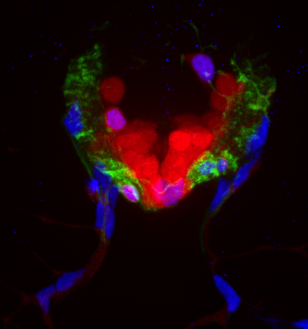
If I only had a brain…and a spinal cord, and a peripheral nervous system…
Brain Awareness Week
Albemarle High School
May 16, 2014

Slide 2
What does your nervous system do?

Slide 3
You have 2 nervous systems: central and peripheral

Slide 4
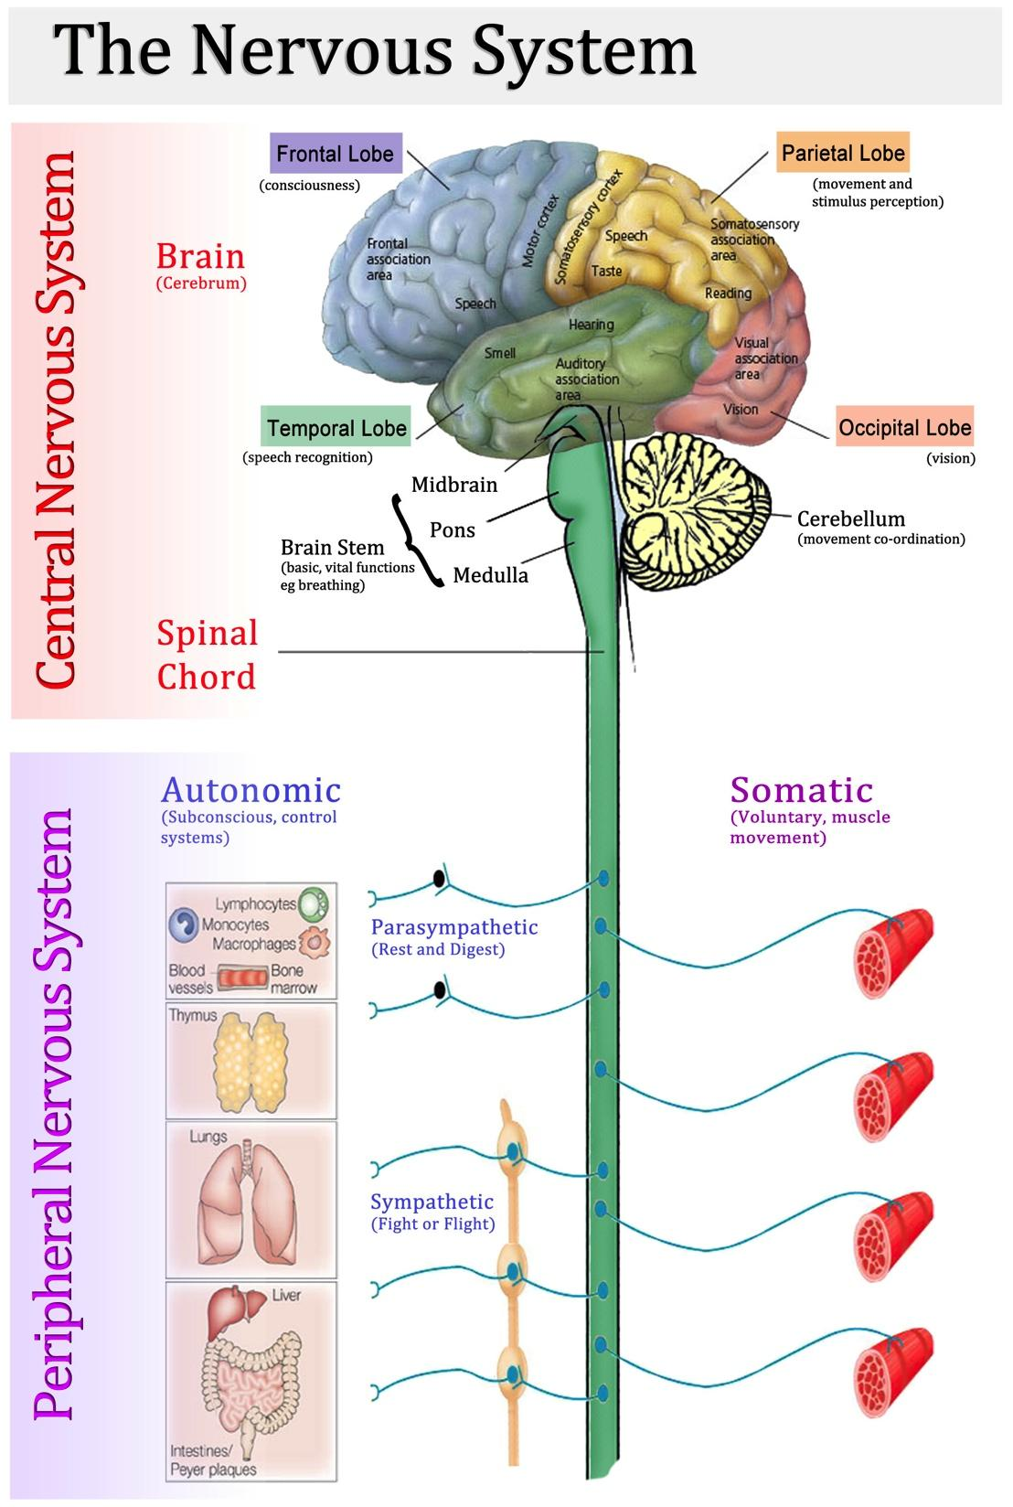
http://healthfavo.com/human-nervous-system-function.html

Slide 5
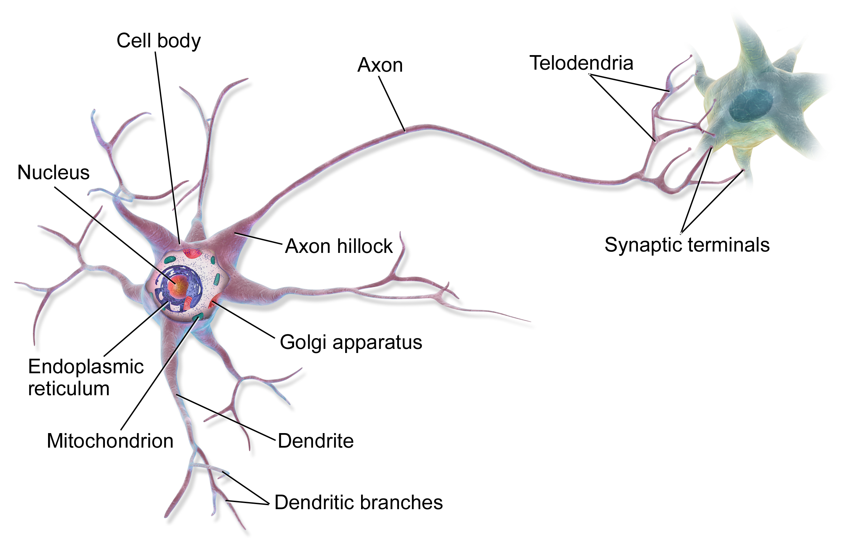
The nervous system is made of cells called neurons

Slide 6
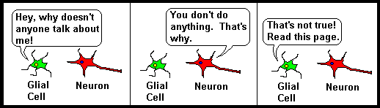
And those other cells…
GLIA!

Slide 7
Glia: a crash course

Slide 8
What do glia do?
Create a healthy environment for neurons
Provide electrical insulation
Tell neurons how to develop
Seek and destroy germs

Slide 9
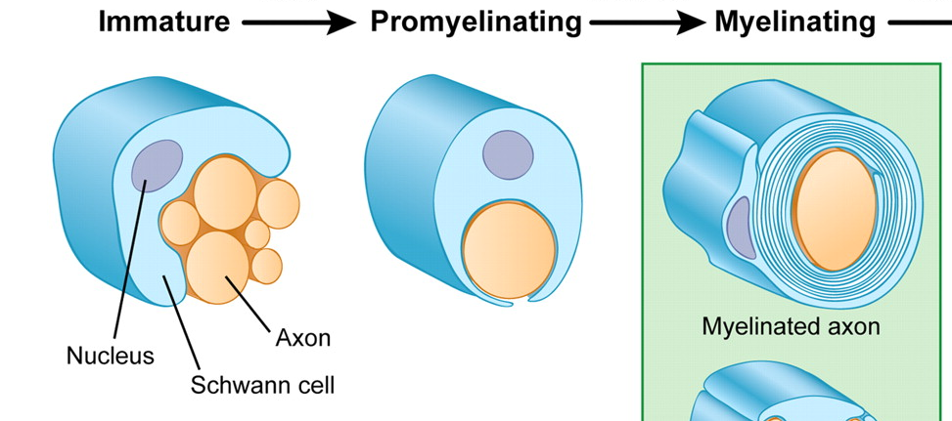
Schwann cells insulate axons of the peripheral nervous system
http://embryology.med.unsw.edu.au/embryology/index.php?title=File:Schwann_cell_myelination_and_dedifferentiation.jpg
Notes:
cartoon

Slide 10
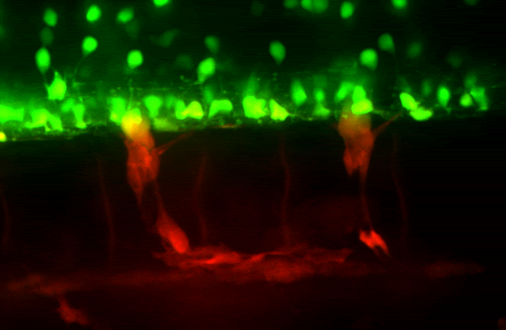
Schwann cells insulate axons of the peripheral nervous system
Notes:
Sox10:eos 57-73 hpf

Slide 11
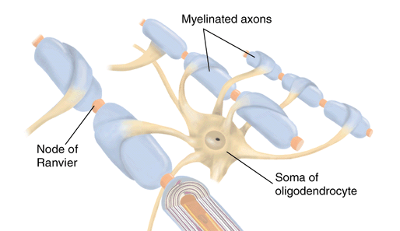
Oligodendrocytes insulate axons of the central nervous system
http://wmaresh.wikispaces.com/09.++Nervous+System
Notes:
cartoon

Slide 12
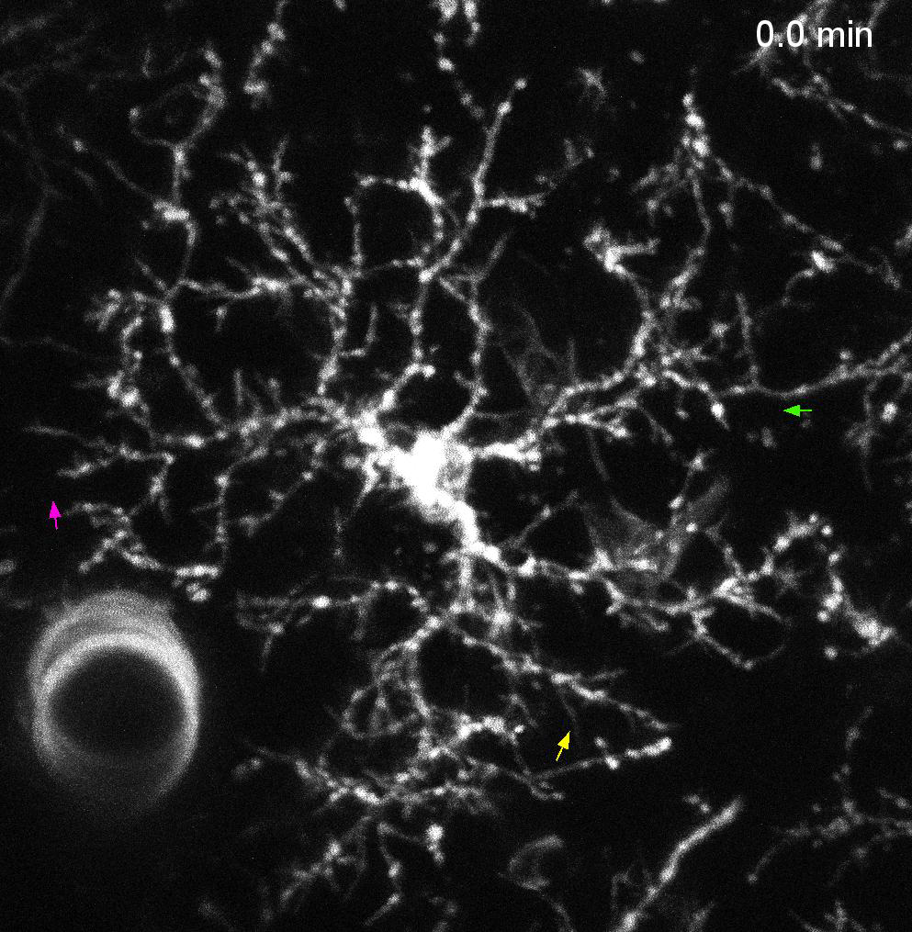
Oligodendrocytes insulate axons of the central nervous system
Hughes EG, Kang SH, Masahiro F and Bergles DE. Oligodendrocyte progenitors balance growth with self-repulsion to achieve homeostasis in the adult brain. Nat Neurosci., 16 (2013) 668-676
Notes:
Movie Lyons paper?
Bergles paper…injury response

Slide 13
Notes:
GO TO THE BOARD!!!!!
Build a nervous system

Slide 14
Our lab studies how glia help the nervous system develop
Notes:
insert a few slides showing the research the lab does

